Slide 1
Big Data Project 1
Brennan Chan & Phuong Thai

Slide 2
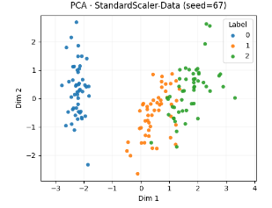
Iris Data PCA with Standard Scaler

Slide 3
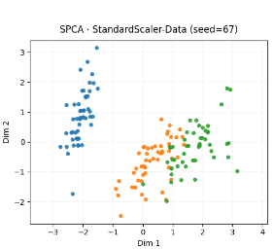
Iris Data SPCA with Standard Scaler

Slide 4
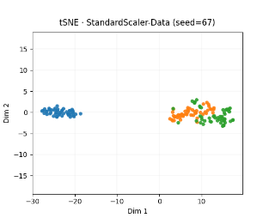
Iris Data t-SNE with Standard Scaler

Slide 5
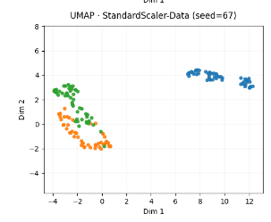
Iris Data UMAP with Standard Scaler

Slide 6
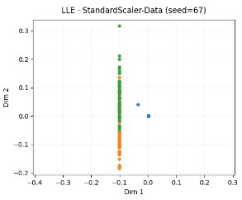
Iris Data LLE with Standard Scaler

Slide 7
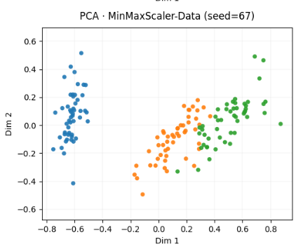
Iris Data PCA with MinMax Scaler

Slide 8
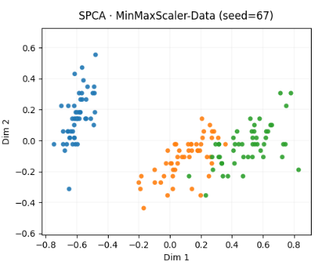
Iris Data SPCA with MinMax Scaler

Slide 9
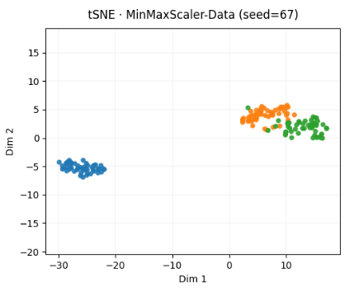
Iris Data t-SNE with MinMax Scaler

Slide 10
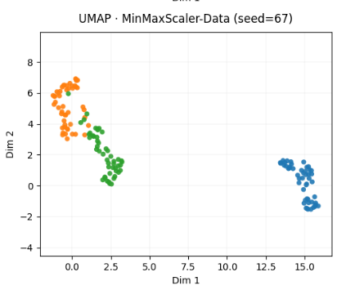
Iris Data UMAP with MinMax Scaler

Slide 11
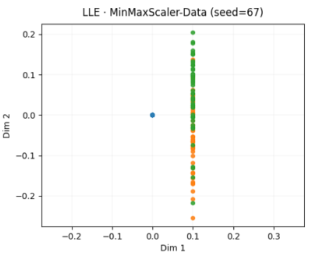
Iris Data LLE with MinMax Scaler

Slide 12
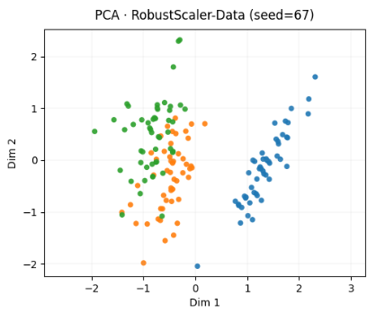
Iris Data PCA with Robust Scaler

Slide 13
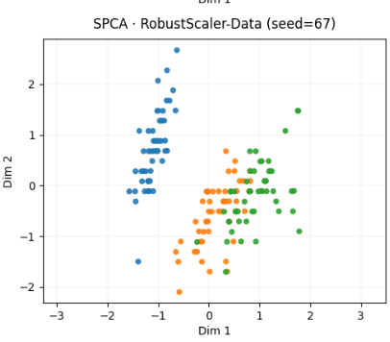
Iris Data SPCA with Robust Scaler

Slide 14
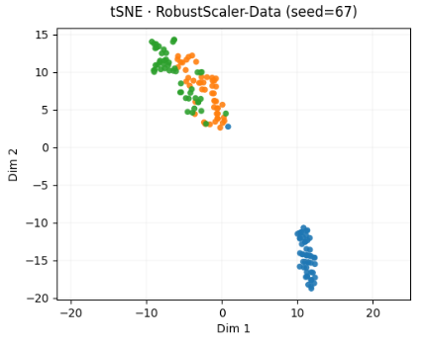
Iris Data t-SNE with Robust Scaler

Slide 15
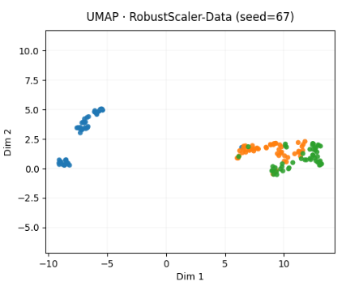
Iris Data UMAP with Robust Scaler

Slide 16
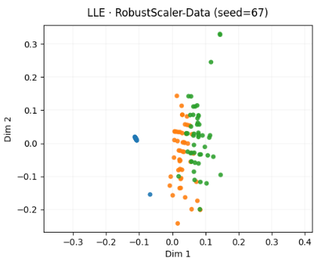
Iris Data LLE with Robust Scaler

Slide 17
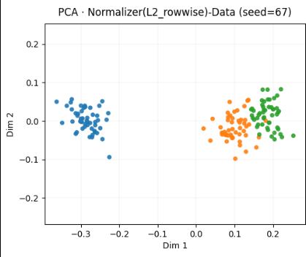
Iris Data PCA with L2 Normalizer

Slide 18
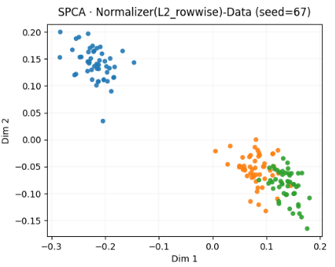
Iris Data SPCA with L2 Normalizer

Slide 19
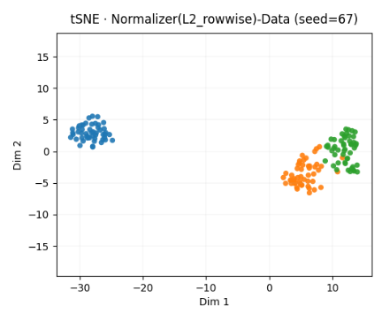
Iris Data t-SNE with L2 Normalizer

Slide 20
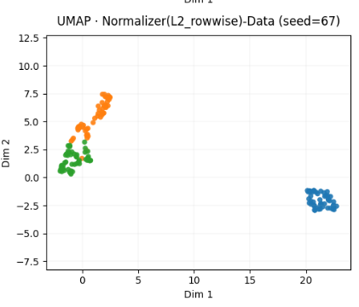
Iris Data UMAP with L2 Normalizer

Slide 21
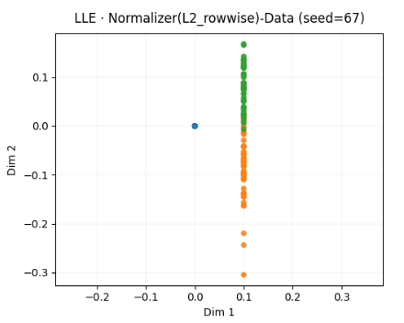
Iris Data LLE with L2 Normalizer

Slide 22
Best Visualization Performances

Slide 23
Locality Conservation Ratios

Slide 24
GDSC Data Binary Labels

Slide 25
GDSC Data PCA with binary labels

Slide 26
GDSC Data t-SNE with binary labels

Slide 27
GDSC Data UMAP with binary labels

Slide 28
GDSC Data LLE with binary labels

Slide 29
GDSC Data t-SNE + DBSCAN

Slide 30
GDSC Data UMAP + DBSCAN

Slide 31
GDSC Data LLE + DBSCAN

Slide 32
Patent Data PCA

Slide 33
Special Patents in Patent Data PCA

Slide 34
Patent Data t-SNE

Slide 35
Patent Data UMAP

Slide 36
Patent Data PHATE

